Slide 1
Overview
Informix Product History
Informix Version & Edition
Development and administration tool
Server Instance Architecture
Informix Architecture

Slide 2
Informix Product History
Informix C-ISAM
Informix Standard Engine (SE)
Informix OnLine 4.x and 5.x (X->The numbers of versions)
Informix Dynamic Server 7.x
Informix Extended Parallel Server 8.x
Informix Dynamic Server 9.x and 10.x
Informix 11.x and 12.x
Informix 14.10 –Current version

Slide 3
Informix Version Number
Example: 11.70.FC7 W1
11 : Major Release
70 : Enhancement Release
F : Architecture
F – 64bit, U – Unix 32bit, T- Windows 32bit
C7 : Sub release number
W1: Fix pack number

Slide 4

Informix Editions
No Cost Editions
IBM Informix Developer Edition
Limits on RAM, CPU and Disk usage
Available on most systems
Not for production use
IBM Informix Innovator-C Edition
No Replication
Limited to one 1 CPU and 2 GB of RAM
Free for use, no re-distribution allowed
Windows, (Intel) Linux and MAC only

Slide 5
Informix Editions
Purchase Editions
Express Edition
4 cores, 8 GB RAM max, limits on licensing
Available on most systems
Workgroup Edition
16 GB of RAM, Flexible Licensing
Available on most systems
Enterprise Edition
Licensed by resources on the server
Available for all of the listed Oses
No software limits on RAM or resources

Slide 6

Licensing Metrics
Processor Value Unit (PVU)
Authorized User Single Install (AUSI)
Limited Use Virtual Server (LUVS)
Limited Use Socket (LU Socket)
– Only for Informix Workgroup
Authorized User (AU)
– Only for Informix Advanced Developer

Slide 7
Development Tools
• Informix ESQL/C
• Informix 4GL
• Informix SQL
• Informix Genero (4J’s)
• Java
• PHP
• Ruby on Rails
• Perl

Slide 8
Informix Administration Tools
• Open Admin Tool (OEM)
• Server Studio (Third Party Tool-Good)
• Gollum (cognizant)
• Command line tool (onstat)
• Informix HQ (By HCL, Only 14.10.FC10)

Slide 9

Server and Instance Architecture
DATABASE SERVER
Instance
Memory
Instance
Disk
Memory
Disk

Slide 10
Informix Architecture
SHARED MEMORY
DISK SPACE (Dbspace)
SERVER PROCESS(oninit)
CLIENT PROCESS

Slide 11
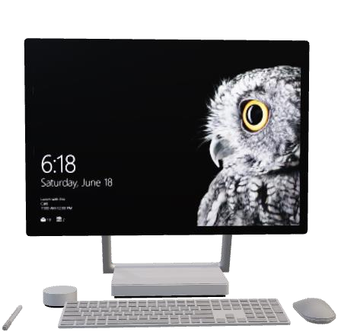









Instance
CLIENT
SHARED MEMORY
DISK
DISK
DISK
PROCESSES

Slide 12


SHARED MEMORY
RESIDENT PORTION
Locks Structure
Shared Memory Header
Max Logs Structure
Locks Structure
BUFFER POOL/BUFFER CACHE
Physical LOG BUFFER
Logical LOG BUFFER
PHYSICAL LOG
LOGICAL LOG
VIRUTAL PORTION
MESSAGE PORTION

Slide 13
VIRTUAL PORTION
INTERNAL TABLE
PROCEDURE
LARGE BUFFER
SORTING POOL
USER SESSION DATA
DICTIONARY CACHE
GLOBAL POOL

Slide 14
MESSAGE PORTION
The message portion of shared memory contains the message buffers that the shared-memory communication interface uses. The amount of space required for these buffers depends on the number of user connections that you allow using a given networking interface.
msegsize = (10,531 * ipcshm_conn + 50,000)/1024

Slide 15

DISK COMPONENT
PAGE HEADER
2K PAGE SIZE
2K | 2K | 2K
2K | 2K | 2K
DBSPACE
CHUNK
CHUNK
CHUNK
PAGE HEADER
4K PAGE SIZE
4k | 4K | 4K
4K | 4K | 4K
CHUNK
CHUNK
CHUNK

Slide 16
Informix Disk Space
• Dbspace – Logical container of Chunks
• Chunk – Physical container
– Raw Disk – Informix direct access to disk
– Cooked Disk – Informix accesses disk through OS filesystem
• Page – (Smallest unit of Disk) I/O Block: 2K, 4K, 8K, 16K
• Tablespace – All pages assigned to a table
• Extent – Set of contiguous pages(Collection of Pages)
* Page header can store in Index

Slide 17
RAW vs Cooked Space
RAW – Informix has direct access to the device and space
Used to be 25% faster
Harder to manage
No UNIX OS Buffering & Overhead
Cooked – A cooked file is a regular file that the operating system manages
Filesystem to access a space
May be Slower
OS Overhead and OS Buffering
Simple Management of Devices

Slide 18
Server Process
CPU - Executes all user and session threads and some system threads
PIO - Handles physical log file when cooked disk space is used
LIO - Handles logical log file when cooked disk space is used
AIO -Handles disk I/O
SHM - Performs shared memory communications
TLI - Performs TLI network communications
SOC - Performs socket network communications
FIFO - Performs FIFO operations
OPT - Handles optical disk I/O
ADM - Executes administrative threads
ADT - Executes auditing threads
MSC - Handles request for system calls

Slide 19
Data storage
Physical units :
Chunks
Pages
Blobpages (b->Binary)
Sbpages We can check Mount point info in “bdf”
Extents df –h or df –k (UNIX mount point info)
Logical units:
Dbspaces
Temporary dbspaces
Blobspaces
Sbspaces
Temporary sbspaces
Plogspace
Extspaces
Databases
Tables
Tblspaces
Partitions and offsets

